Slide 1

The Educator
Team: GameChangers
Syed M. Ashhar &
M. Hamza
Edge Runners 3.2

Slide 2

Problem Statement
Challenges in accessing education in remote areas:
Lack of access to high speed internet
Lack of access to high performance computers and laptops
Lack of steady electricity supply
Link

Slide 3
Solution Overview
Project Overview
A mobile and server-based AI application
Designed to provide educational support in remote areas with limited or no internet.
Utilizes lightweight open-source text generation models, llama-3.2-1B and 3.2-3B, enabling students access to GenAI technology offline.
A server, installed at a central location like a school, runs more advanced models, llama-3.2-11B and 3.2-90B, with multi-modal capabilities.
When connected, the app can process images and leverage RAG to provide enhanced, detailed explanations.

Slide 4
The Core Technologies
Llama-3.2-1B and 3.2-3B (Lightweight LLMs)
Multi-modal Capabilities
Smaller open-source language models designed to run efficiently on mobile devices. Enables offline question-answering and educational support directly on student smartphones, without requiring internet access.
The ability of the AI models to understand and process different types of data, such as text and image. Students can take pictures of textbook content, and the server-based models can provide detailed explanations, enhancing learning through visual aids
Llama-3.2-11B and 3.2-90B (Advanced LLMs with Multi-modal Capabilities)
Retrieval-Augmented Generation (RAG)
larger models run on a local server, offering more powerful AI capabilities, including the ability to process text and images. App can perform more complex tasks like explaining images from textbooks and delivering richer educational content.
Combines language model outputs with external documents to provide more accurate and contextually relevant answers. The AI can pull information from a school’s database or stored documents to deliver precise responses, improving the relevance of the educational content provided to students.

Slide 5
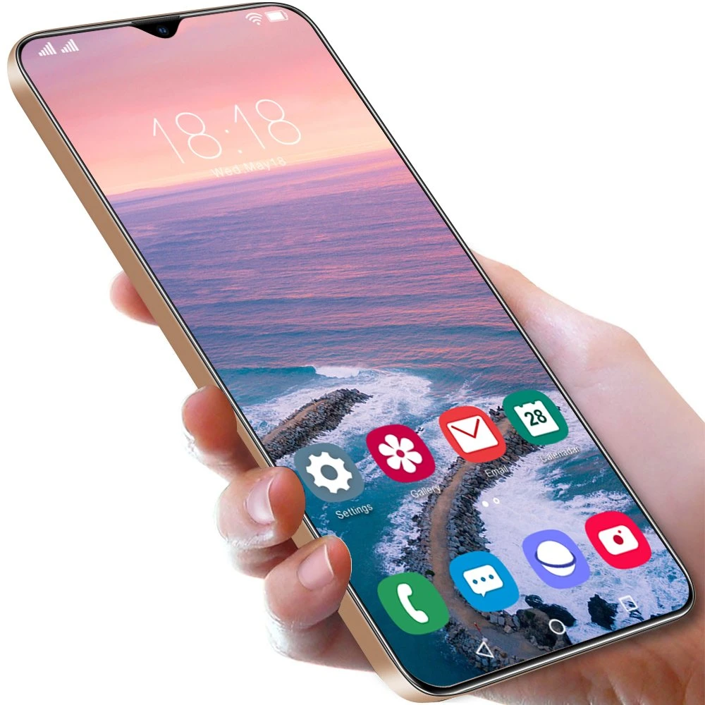
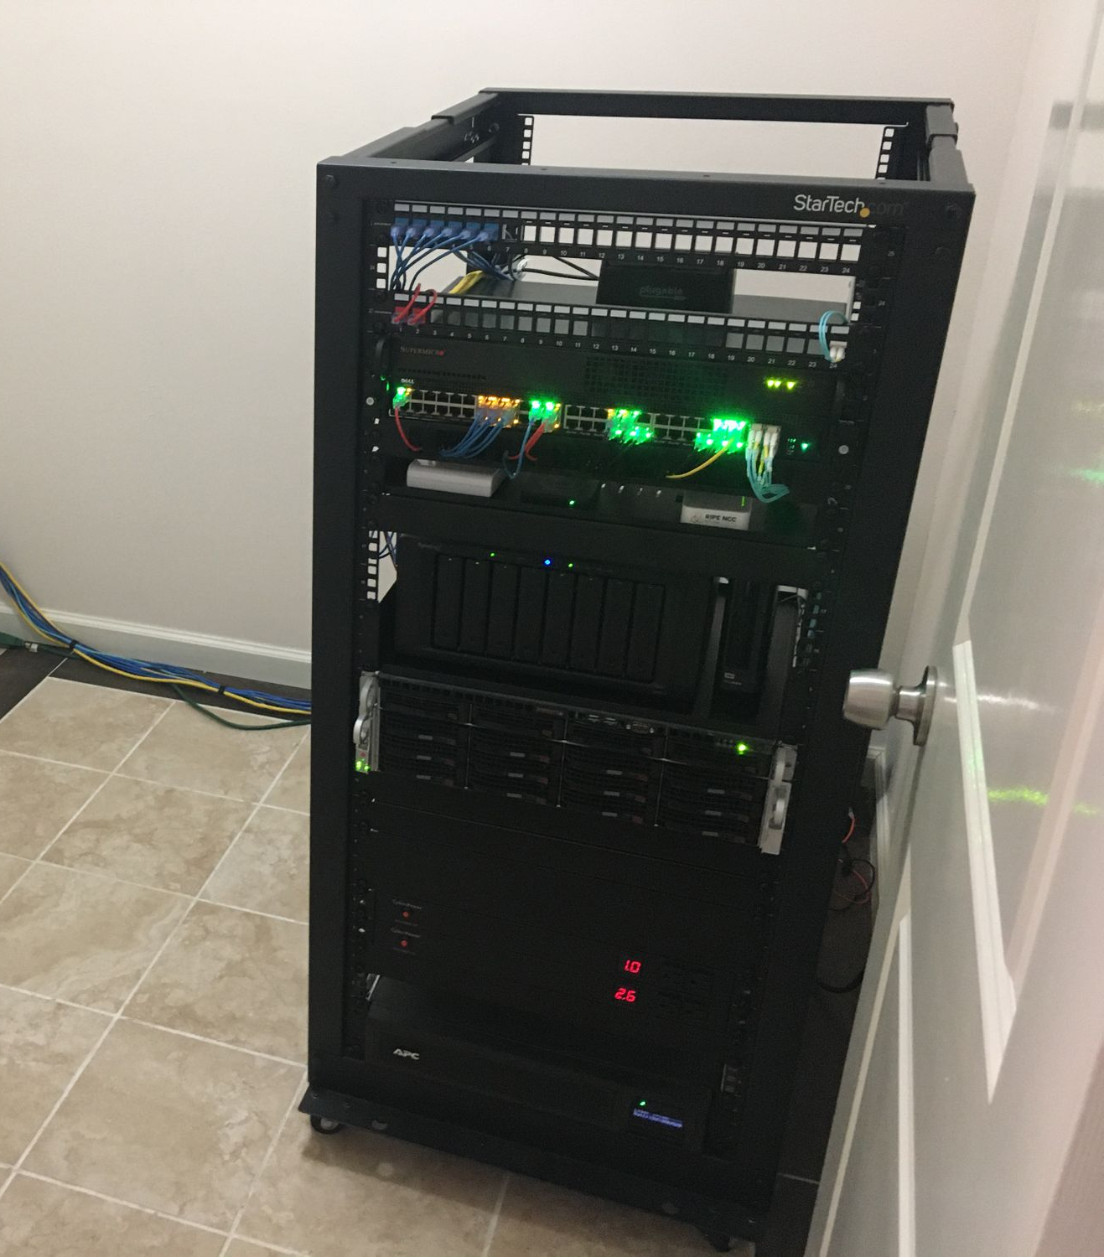
System Architecture
Hardware requirements

Slide 6
System Architecture
Offline Mode Functionality
Runs on students' smartphones using llama-3.2-1B and 3.2-3B models
App provides answers based on its locally stored knowledge
With no internet service
Benefits:
24/7 Access: Students can get immediate answers to educational queries anytime.
No Internet Dependency: Fully functional without a network connection, ensuring uninterrupted learning.

Slide 7
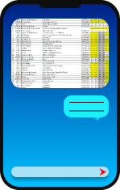

System Architecture
Server Connection Mode
Mobile application connects to the local server via Wi-Fi
Gains access to advanced AI models (llama-3.2-11B and 3.2-90B) with multi-modal capabilities
Can upload images of textbook pages for detailed explanations
Server can handle both text and image inputs, offering a richer learning experience.
Benefits:
Vision Tasks: Students can upload images for in-depth analysis and explanation.
Advanced AI Support: Larger models provide more comprehensive answers and support more complex queries.

Slide 8
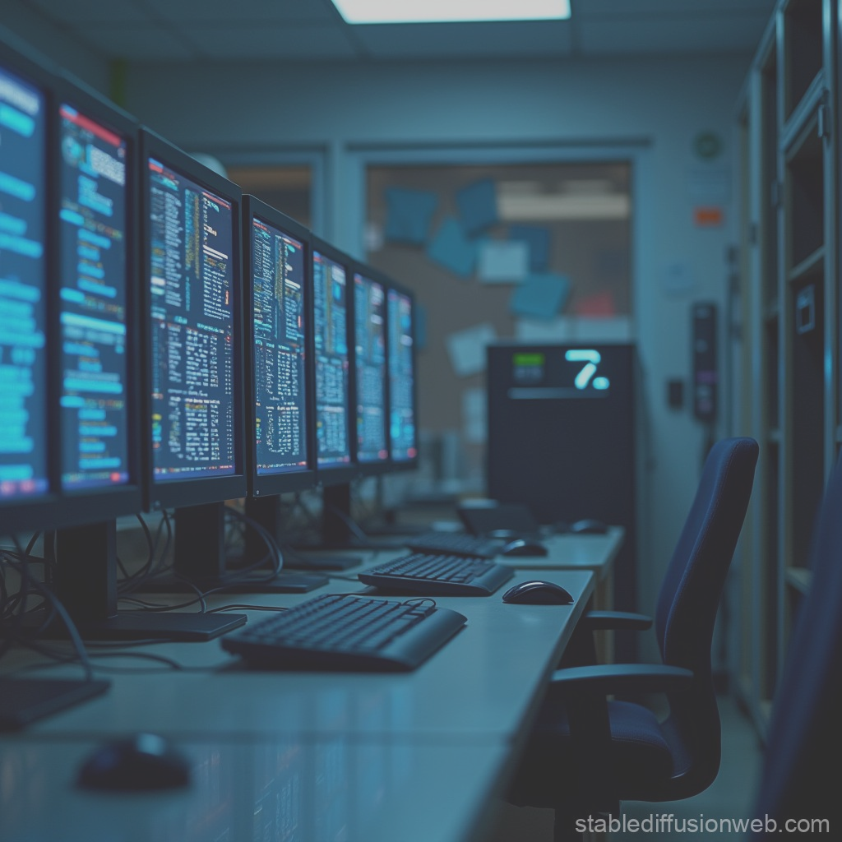


Use Cases
Scenario 1 – Visual Learning
Take Picture
Send to Server
Explanation Received

Slide 9


Use Cases
Scenario 2 – Textbook Questioning
Ask Question
Local LLM / Server RAG
Answer received

Slide 10
Technical Aspects
Vision Capabilities:
Server-based LLMs (11B, 90B) offer multi-modal learning, processing images like textbook pages and providing detailed explanations or clarifications.
LLMs for Offline Queries:
Mobile app uses llama-3.2-1B and 3.2-3B to answer educational queries locally, ensuring offline functionality.
Seamless Integration:
The app combines text-based and image-based AI functionalities, delivering a comprehensive learning experience for students in remote areas.
RAG for Enhanced Answers:
When connected to the server, the Retrieval-Augmented Generation (RAG) system pulls relevant documents to provide accurate, context-driven responses.

Slide 11

Deployment in Remote Areas
01
Server Setup in Central Location
03
Local Wi-Fi Installation
Install the server with advanced AI models (llama-3.2-11B and 90B) at a school or community hub. Preferably with a renewable energy source for 24/7 operation
Set up a local Wi-Fi network for students to connect to the server when within the vicinity.
02
Mobile App Distribution
04
05
Ongoing Maintenance
Sync and Update Mechanism
Pre-install the mobile application on student smartphones, equipped with llama-3.2-1B and 3.2-3B for offline functionality
Enable the app to sync with the server periodically, updating content and enabling enhanced capabilities like image recognition.
Ensure regular server maintenance and updates to improve AI performance and expand resources.

Slide 12



Improved Learning Outcomes
Students gain access to AI-driven, personalized support, enabling deeper understanding of complex topics.
24/7 Educational Access
The offline functionality ensures students can learn anytime, without being limited by internet availability.
Bridging the Knowledge Gap
The app provides access to vast resources and explanations, reducing educational inequality in remote areas.

Slide 13

Future Developments
Hardware Improvements
Future, more efficient hardware to boost performance, allowing faster, more advanced AI processing.
Expanded RAG Functionality
Broader integration of RAG, enhance the app’s ability to retrieve diverse educational materials.
Broader Deployment
Can be scaled to more remote regions globally, expanding its impact and accessibility
Increased Multi-modal Support
Continued development to handle more complex educational content, such as videos or interactive simulations.

Slide 14

Conclusion
Innovative AI Solution
Our mobile and server-based application brings advanced educational support to remote areas with minimal or no internet.
Accessible Learning
Offline functionality ensures students can access knowledge anytime, while server connectivity provides enhanced features like image recognition.
Bridging Educational Gaps
The solution helps reduce educational inequality by delivering personalized learning and access to vast resources in underserved regions.
Global Impact
This project holds the potential to revolutionize education in remote areas, empowering students worldwide with AI-driven knowledge.
Photo by Daily Nigerian

Slide 15
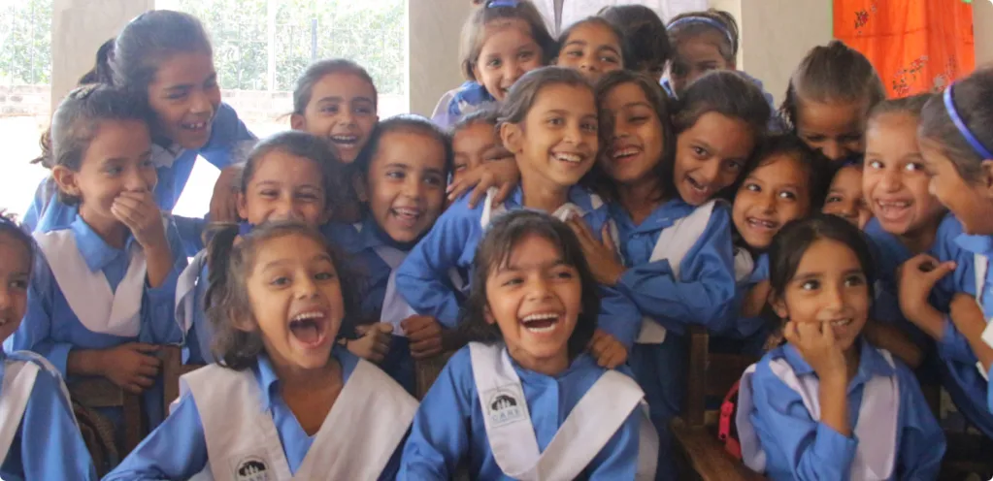
Thank you

